Slide 1
THE COMMON LEVEL RATIO
MIKE SULEY 2022

Slide 2

IS THE COMMON LEVEL RATIO APPLIED FAIRLY IN ALLEGHENY COUNTY?

Slide 3
  Mike Suley is an Associate Broker/ Realtor with KW Realty. He is a state licensed Real Estate Broker and State Certified Assessor [CPE.] CPE not active
  Allegheny County Board of Property Assessment Appeals and Review during the first court-ordered countywide reassessment from 1997-2000
  Manager of the Office of Property Assessments during the second court-ordered reassessment of 2012.
  Tax consultant assisting hundreds of taxpayers
  Assessment Consultant [2005-2006] to the Allegheny County Law Department.
  President of the REALTORS Association of Metropolitan Pittsburgh in 1990.

Slide 4
Allegheny County failed to administer the property tax assessment appeal in a just and impartial manner
Judge Hertzberg Opinion
November 14, 2022

Slide 5
“From this evidence there could be be no doubt that Allegheny County’s Office of Property Assessment had been “cooking the books” on CLR data submitted to (the state) STEB.”
Common Pleas Court Judge Alan Hertzberg (Gioffre)
November 14, 2022

Slide 6
Gioffre v Fitzgerald Timeline
JUNE 2021 – Suit Filed
July, 2021 New CLR 81.1
APRIL 27, 2022 – Consent Order
SEPTEMBER 1, 2022 – Court order
New CLR is 63.53 – Send to STEB
Sept 2022 - Pgh School District Appeal to Commonwealth Court

Slide 7
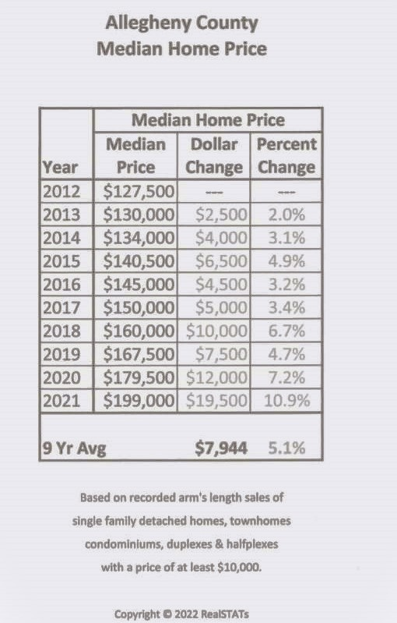
WHEN VALUES GO UP
THE CLR GOES DOWN
SOURCE: RealSTATS

Slide 8
ALLEGHENY COUNTY
COMMON LEVEL RATIOS
YEAR CLR
2016 87.4
2017 87.5
2018 86.2
2019 87.5
2020 81.1

Slide 9
THE IMMACULATE DECEPTION 2.0
PITTSBURGH PUBLIC SCHOOLS HAIL MARY

Slide 10
WREAK HAVOC WITH BUDGET?
PITTSBURGH PARCELS
125,000
PPS 2022 APPEALS
854 .6%

Slide 11
“School District of Pittsburgh, a beneficiary of taxpayers contributing more than their fair share, refuses to allow Allegheny County to accept responsibility and correct its improper assessment appeal system. Instead, the school district wants the taxpayers that it targets with property assessment appeals to continue paying more than their fair share.”
Judge Hertzberg Opinion November 14, 2002

Slide 12
The school district was ordered to adjust its tax millage downward. The court held that Act 146 was a guarantee to the taxpayers that they would not be paying a hidden tax increase (after excluding a five percent inflation adjustment and new construction). The purpose of Act 146 was to prevent a taxing body from increasing taxes where the public did not know that this was taking place.
PPS lowered millage from 13.92 to 13.22
PPS exceeded 105% cap overcharging taxpayers
600 Grant Street Associates Limited Partnership v. City of Pittsburgh (2001) Judge Wettick

Slide 13
Mr. Suley states that an inspection of the process to calculate real estate taxes "may reveal evidence that a crime has been committed." This is an exaggeration bordering on a deliberate falsehood. There is no crime being committed.
Mr. Suley states that an inspection of the process to calculate real estate taxes "may reveal evidence that a crime has been committed." This is an exaggeration bordering on a deliberate falsehood. There is no crime being committed. Local governments, municipalities and school districts are grappling with
Pittsburgh Post-Gazette – Ira Weiss 5/8/2013

Slide 14

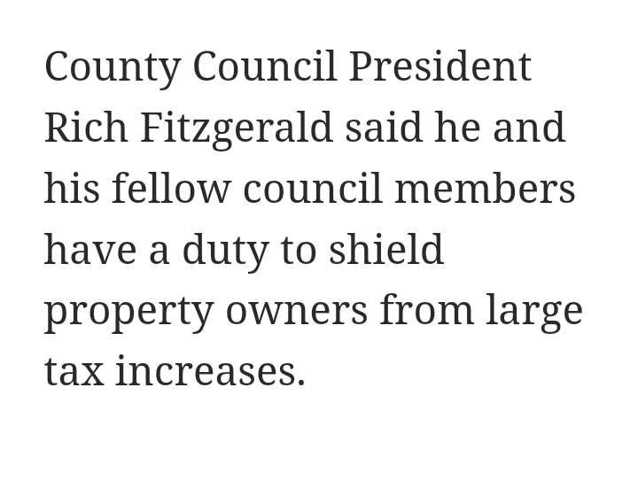
2005 PITTSSBURGH POST-GAZETTE

Slide 15
Mr. Fitzgerald said he believes a reassessment would put Allegheny County at a competitive disadvantage, noting that many of the counties surrounding it haven’t reassessed in decades.
Since the last court-ordered reassessment in the county, median sales prices for houses have increased to about $250,000 from about $100,000, Mr. Fitzgerald said. “That means we’ve helped a lot of people increase their net worth by paying their mortgage over the last 10 years.”
2021 PITTSBURGH POST-GAZETTE

Slide 16
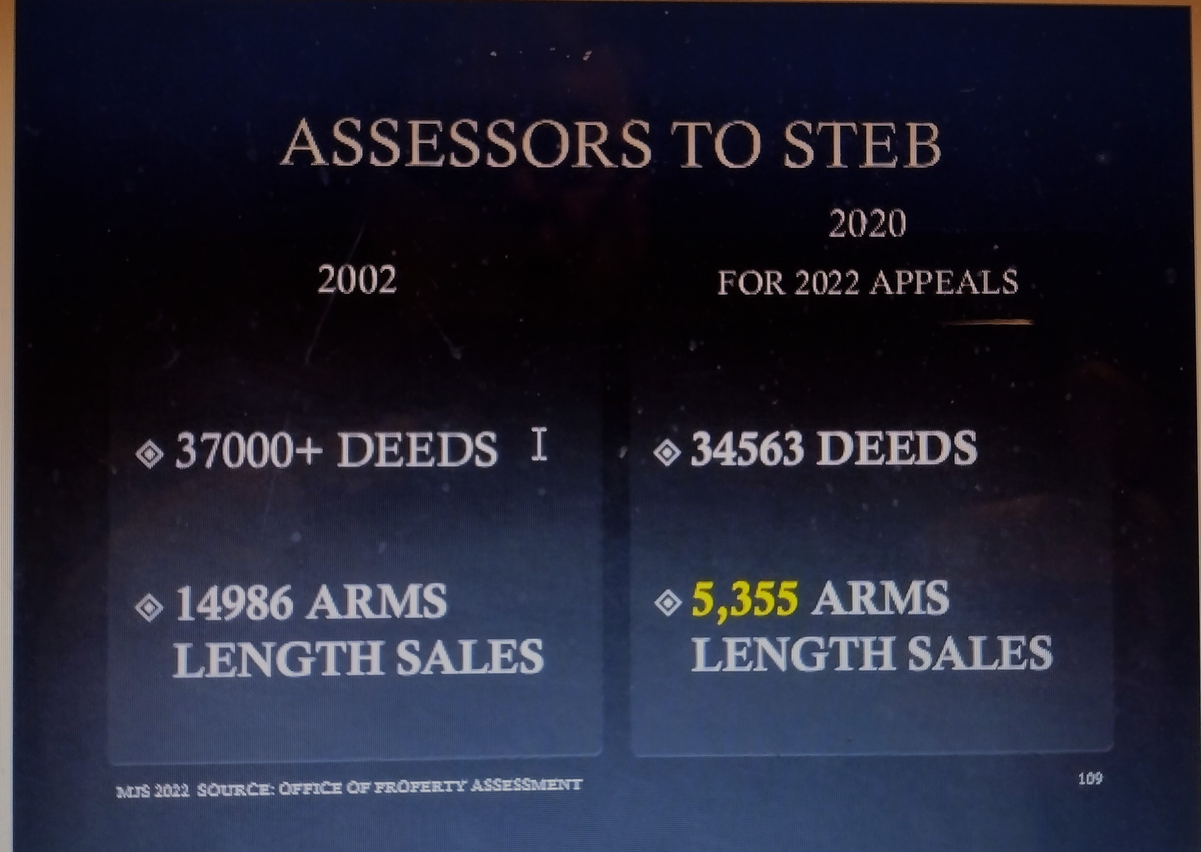
COMMON LEVEL RATIO
2019 RECIPROCALS
    Allegheny County 1.16
    Beaver 4.59
    Butler 10.75
    Washington 1.11
    Westmoreland 6.94
    Fayette 1.40
    CLR Reciprocal X Assessment + CMV

Slide 17
COMMON LEVEL RATIO
The ratio of assessed value to current market value used generally in the county as last determined …annually…by the Tax Equalization Board (formally the State Tax Equalization Board) pursuant to the act of June 27, 1947 (P.L.1046, No.447), referred to as the State Tax equalization Board Law, 72 P.S. 4656.1 et seq.

Slide 18
STEB
ASSESSMENT ACCURACY
Aggregate sales from 67 counties
Arm’s length sales
ratio of:
Aggregate sale prices countywide
Aggregate assessments countywide
Issues common level ratio annually July 1

Slide 19
JUST THE FACTS
2012 Reassessment 92% of MV
2022 Appeals CLR 81.1% of MV
2020 Sales Price
Appeals is a two-Step Process

Slide 20
COMMON LEVEL RATIOS*
2012
Allegheny County 100% *
Beaver 31.5%
Butler 13.5%
Washington 12.7%
Westmoreland 21.4%
*Ted/Tax Equalization Division
92% of MV

Slide 21
COMMON LEVEL RATIOS*
2013
Allegheny County 90.8
Beaver 29.3
Butler 11.4
Washington 10.9
Westmoreland 19.3
*TED/Tax Equalization Division –June 2014

Slide 22
COMMON LEVEL RATIOS*
2014
Allegheny County 92
Beaver 27.5
Butler 10.6
Washington 10.5
Westmoreland 19.8
*TED/Tax Equalization Division –July, 2015

Slide 23
COMMON LEVEL RATIO
2015
    Allegheny County 87.1%
    Beaver 27.8%
    Butler 10.9%
    Washington 10.7%
    Westmoreland 17.3%
    Fayette 72.5%

Slide 24
COMMON LEVEL RATIO
2016
    Allegheny County 87.4%
    Beaver 26.1%
    Butler 10.8%
    Washington 10%*r
    Westmoreland 16.2%
    Fayette 71.6%

Slide 25
COMMON LEVEL RATIO
2017
    Allegheny County 87.5%
    Beaver 25.1%
    Butler 10.6%
    Washington 95.3%
    Westmoreland 16.3%
    Fayette 71.3%

Slide 26
COMMON LEVEL RATIO
2018
    Allegheny County 86.2%
    Beaver 21.8%
    Butler 9.3%
    Washington 90.1%
    Westmoreland 14.4%
    Fayette 71.5%

Slide 27
COMMON LEVEL RATIO
2019*
    Allegheny County (*2021 Appeals) 87.5%
    Beaver 18.1%
    Butler 8.6%
    Washington 85.4%
    Westmoreland 13.1%
    Fayette 58.8%

Slide 28
September 1, 2022
Court Order
63.53 Common Level Ratio
COMMON LEVEL RATIO
*2020 [FOR 2022 TAX YEAR]
Allegheny County 81.1
Beaver 16.5
Butler 7.9
Washington 86.8
Westmoreland 12.3
Fayette 55.8

Slide 29
COMMON LEVEL RATIO APPLICATION
$100,000 SALE PRICE
X
63.53% = $63,530 AV*
* ASSESSED VALUE

Slide 30
IN AN ASSESSMENT APPEAL IN ALLEGHENY COUNTY A TAXPAYER MAY ELECT TO ARGUE:
    Current Market Value
    Base Year (2012) Value

Slide 31
2022 APPEALS ALLEGHENY COUNTY
90% OF THE APPEALS ARE SCHOOL DISTRICT/MUNI APPEALS
Real Estate | Appeal Status | Allegheny County

Slide 32
IF THE COMMON LEVEL RATIO IS CALCULATED INCORRECTLY…………
THE TAX BILL IS NOT UNIFORM AND THE TAXPAYER WILL PAY A HIGHER OR LOWER
PROPERTY TAX

Slide 33

IT DOESN’T MATTER WHICH TAXING BODY FILES THE APPEAL
THE COUNTY IS A TAXING BODY AND NEVER FILES APPEALS
ALL THREE TAXING BODIES BENEFIT FROM INCREASED ASSESSMENTS ON APPEAL

Slide 34
“ It’s a cash cow,” Mr. Suley said. “If you do a terrible job assessing properties, it’s a cash cow in appeals.”
.
2019 PITTSBURGH POST-GAZETTE

Slide 35
ASSESSMENTS
PLACE THE OFFICE OF PROPERTY ASSESSMENTS UNDER THE COUNTY TREASURER’S OFFICE - CAO * SIX YEAR TERM
APPEALS
CREATE A NEW BOARD OF PROPERTY ASSESSMENT APPEALS AND REVIEW -
FULL-TIME, TRAINED BOARD MEMBERS HEAR ALL APPEALS – AUXILIARY BOARDS

Slide 36
BENEFITS TO COUNTY TAXPAYERS
CONSISTANCY
STABILITY
INTEGRITY
UNIFORMITY

Slide 37
THE END

