Slide 1

PMC Shares™
Landlord-Tenant Disputes
Hosted by: Allegheny County Law Library
Presenters: Judge David Barton & Judge Richard King
September 22, 2021
Pennsylvanians for Modern Courts

Slide 2


30 Years of Fighting for Fair Courts in Pennsylvania
PENNSYLVANIANS FOR MODERN COURTS
Pennsylvanians for Modern Courts is the only statewide, nonpartisan nonprofit organization dedicated to ensuring that all Pennsylvanians can come to our courts with confidence that they will be heard by qualified, fair and impartial judges.

Slide 3


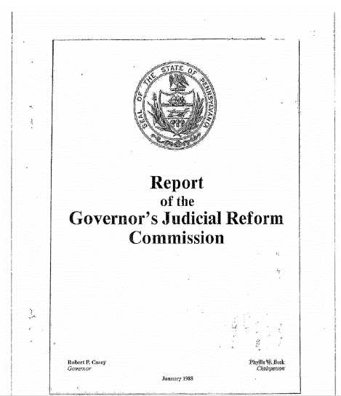
PMC’s History
PENNSYLVANIANS FOR MODERN COURTS
Governor Robert Casey commissioned a blue-ribbon panel of civic leaders, public officials, legal professionals and members of the judiciary to examine judicial reforms. Then Superior Court Judge Phyllis W. Beck chaired the commission.
​The panel discovered that confidence in the judiciary was appallingly low, in large part due to the system of electing judges and the fundraising that goes along with it.
​This finding, combined with several scandals in the late 1980s involving Pennsylvania judges, led our founders to determine that a nonprofit organization was needed to fill the vacuum of judicial oversight and be a herald for judicial ethics.

Slide 4
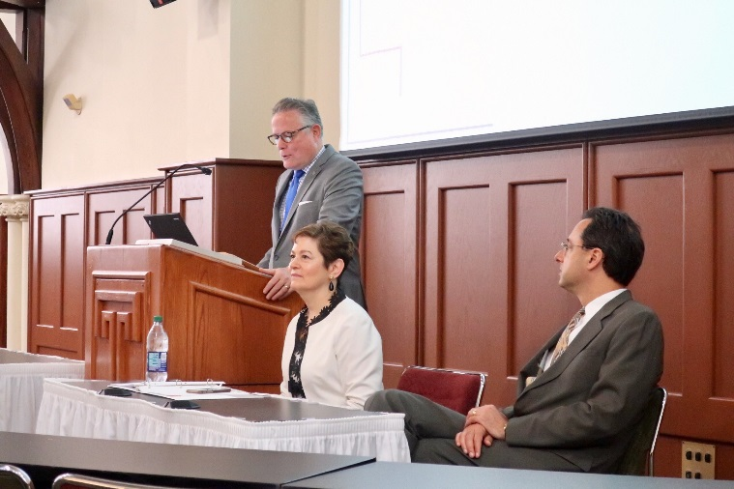
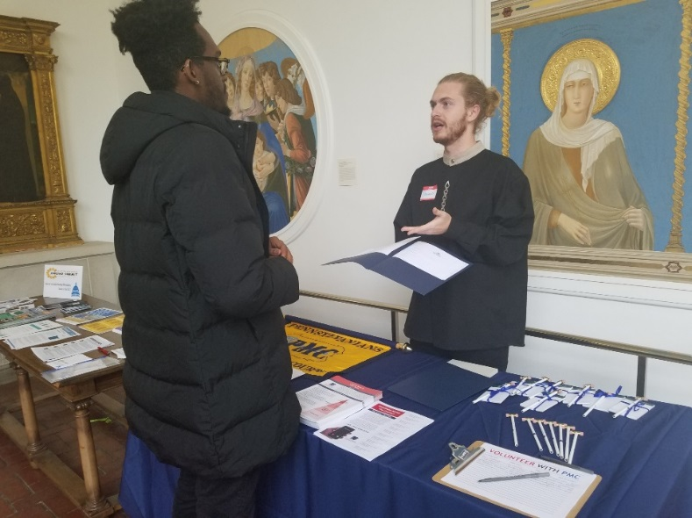
The Work We Do
PENNSYLVANIANS FOR MODERN COURTS
Advocacy:
  Judicial Selection Reform
  Judicial Discipline Reform
  Bail Hearing Reform
Civic Education about the Judiciary
  Judicial Election Forums and programs
  Continuing Legal and Judicial Education: ethics courses for judges and lawyers
  The Media, The Courts & Counsel™
  PMC in the Community™: public education about the courts

Slide 5

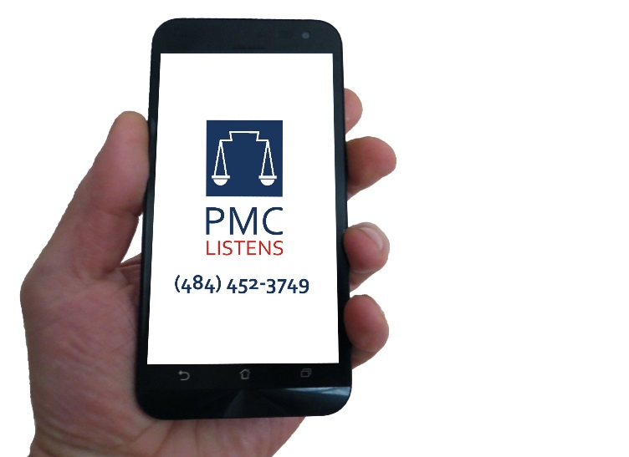
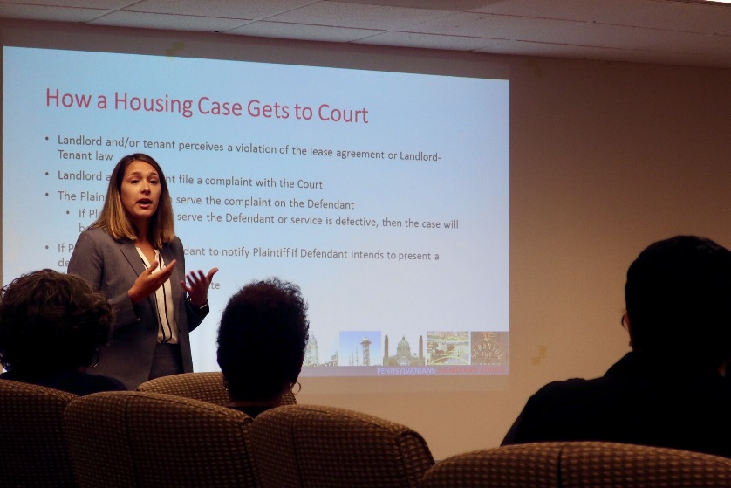
PMC in the Community™
PENNSYLVANIANS FOR MODERN COURTS
PMC Watches™
PMC Listens™
PMC Shares™
(267) 834-5256

Slide 6
What to know before going to Court
PENNSYLVANIANS FOR MODERN COURTS

Slide 7
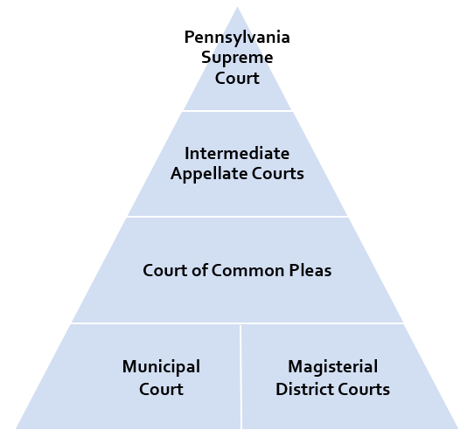
Where do landlord-tenant disputes fit in?
PENNSYLVANIANS FOR MODERN COURTS
Magisterial District Courts
  Small civil actions (amount in controversy less than $12,000)
  Landlord-tenant matters (can waive jurisdictional limits)
  Summary offenses
  Violations of municipal ordinances
  Preliminary hearings and arraignments in greater misdemeanor and felony offenses

Slide 8
What are a tenant’s rights?
PENNSYLVANIANS FOR MODERN COURTS
Federal and Pennsylvania laws tell us that all individuals have rights against discrimination when they are searching for housing and when they become tenants.
Discrimination: a landlord, real estate agent or mortgage broker refuses service or changes the quality of service because of color, age, religion, national origin, sex, gender identity, sexual orientation, disability or familial status.
Housing discrimination is illegal!
Instances of discrimination do not require the tenant to go to court. Instead, if a tenant feels that they have been discriminated against, they may file a complaint with the Department of Housing and Urban Development (HUD) (888-799-2085) or with Pennsylvania’s Human Relations Commission (855-866-5718) or County departments on human rights.

Slide 9
Examples of Discrimination
PENNSYLVANIANS FOR MODERN COURTS
The landlord says that the rent is higher than advertised after meeting the potential tenant in person
The landlord does not allow full use of all home facilities because of race
An advertisement states that a property is only available to people without children

Slide 10
What other rights do tenants have?
PENNSYLVANIANS FOR MODERN COURTS
A landlord cannot do the following to a tenant:
  Take or sell a tenant’s property if they do not pay rent
  Shut off utilities or lock a tenant out of the property if they do not pay rent (also known as self-help evictions)
  Harass a tenant (what a reasonable person believes)
  Enter the property or allow others to enter the property without giving notice (except in an emergency)
  Require a deposit for an assistance animal (medical prescription)
  Cancel an existing lease of the tenant’s if the building is sold to a new landlord
Tenant has a covenant of quiet enjoyment

Slide 11
What are a landlord’s rights?
PENNSYLVANIANS FOR MODERN COURTS
A landlord can set rules about how the property and common areas can be used.
They are entitled to having keys to the property – if tenant changes the locks, must give landlord a copy.
They MUST pursue evictions through the court system – no SELF-HELP eviction.
Landlords have the right to evict a tenant if they do not pay rent or do not pay on time consistently or if they break or breach agreements in the lease. (a breach can be repaired)
Landlords may require security deposits.
Landlords are not responsible for a tenant’s personal belongings.

Slide 12
What are a tenant’s responsibilities?
PENNSYLVANIANS FOR MODERN COURTS
A tenant’s main responsibility is to pay the rent and to pay it on time.
They must also obey the terms of the lease.
  If the lease states that the tenant must pay utilities, the tenant must get the bills from landlord.
  Make sure to get a signed copy of the lease to monitor the rules and terms so you can obey them.
The tenant must communicate with the landlord about repair issues as soon as they occur. It is best to do this in writing and to keep a copy of this notice. If there are issues affecting health and the landlord doesn’t respond in a reasonable time, can call the Allegheny County Health Inspector
The tenant should return the property to the way it was when they moved in, minus reasonable wear and tear, removing all belongings.
(if you paint the walls, and they were white when you moved in, you may have to paint them back to white.)

Slide 13
What are a landlord’s responsibilities?
PENNSYLVANIANS FOR MODERN COURTS
Main duty: maintain the property in good condition.
  Safe, sanitary and accessible as determined by housing codes.
  Repairs completed in a reasonable time.
  Not required to pay for/repair damage caused by tenant.
  Multi-unit building: landlord is responsible for maintaining common areas.
  To meet safety and cleanliness standards, a landlord must provide:
Drinkable water in the kitchen and bathroom Functioning bathroom with toilet and shower/tub Safe and functioning electrical system No chipped or peeling paint | Hot water Heat during cold months (no cool air required unless written in lease) Working sewage system Working smoke alarms

Slide 14
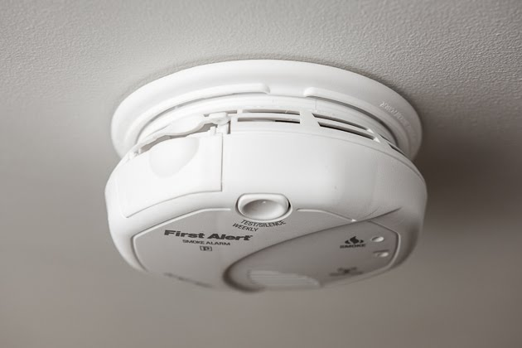

Landlord Responsibilities (Continued)
PENNSYLVANIANS FOR MODERN COURTS
A landlord MUST inform a tenant of lead-paint/lead-pipes in the property before a tenant signs a lease. Landlord can be sued for triple the amount of damages.
If the tenant pays the utilities separately from the rent, the landlord must install separate meters. If they cannot be metered separately, the landlord must pay the utility bill and add it to the rent.
If a tenant tells the landlord that the smoke alarm is broken, the landlord has 72 hours to replace it.

Slide 15
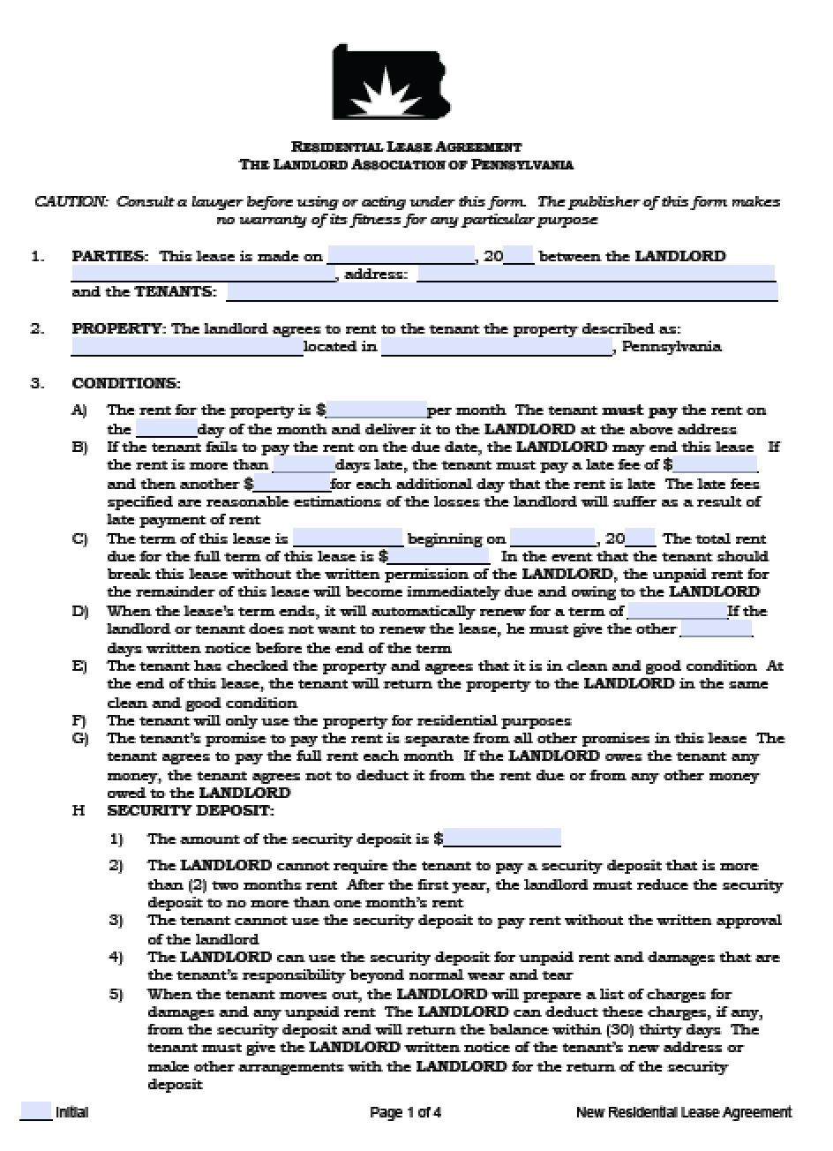
What is a lease?
PENNSYLVANIANS FOR MODERN COURTS
A lease is an agreement between a landlord and tenant that a tenant can occupy and use a property for a certain amount of time in exchange for rent.
Be sure to fully understand and agree with its terms before signing!
Leases can be oral or written. An oral agreement is technically month to month. An oral lease must have less than a 3 year term. If it is more, the lease must be in writing or there is no agreement.
The lease must be written in PLAIN LANGUAGE. No fine print.

Slide 16
What can a lease contain?
PENNSYLVANIANS FOR MODERN COURTS
The lease term: what dates is the tenant allowed to live there? When is move-in?
Repairs: who must make repairs?
Smoke Alarms: who is responsible to check the smoke alarms?
Visitors: can other people stay for an extended amount of time?
Entering: must the landlord provide the tenant notice before entering the property?
Utilities: who pays for which utilities?
Late charges: are there any late charges?
Who responsible for snow? For leaves? For trash?
***IMPORTANT*** In some leases, there is a Waiver of Notice to Quit clause. If a tenant signs a lease that has this clause, the landlord does not have to give them notice of eviction. Instead, the landlord can take direct legal action without telling the tenant.

Slide 17
Resolving issues outside of the court
PENNSYLVANIANS FOR MODERN COURTS
When any problem arises, the tenant should send a written notice to the landlord. If the landlord does not respond or does nothing, the tenant should send a second notice. Important to keep records, put everything in writing.
Security Deposit: A landlord has 30 days to return it. If any money is deducted, the landlord must itemize deductions or the tenant can sue for twice the amount.
Repairs: Take pictures of damage. Call 311 to file a complaint with the Department of Permits, Licenses and Inspections. A health and housing code inspector will be sent. DO THIS BEFORE FILING ANY COMPLAINT.
  Repair and Deduct: Landlord must be notified of issue and not responded, tenant makes repairs and deducts costs from future rent. Cannot exceed the monthly rent amount. Keep receipts and estimates and inform the landlord of this action.

Slide 18
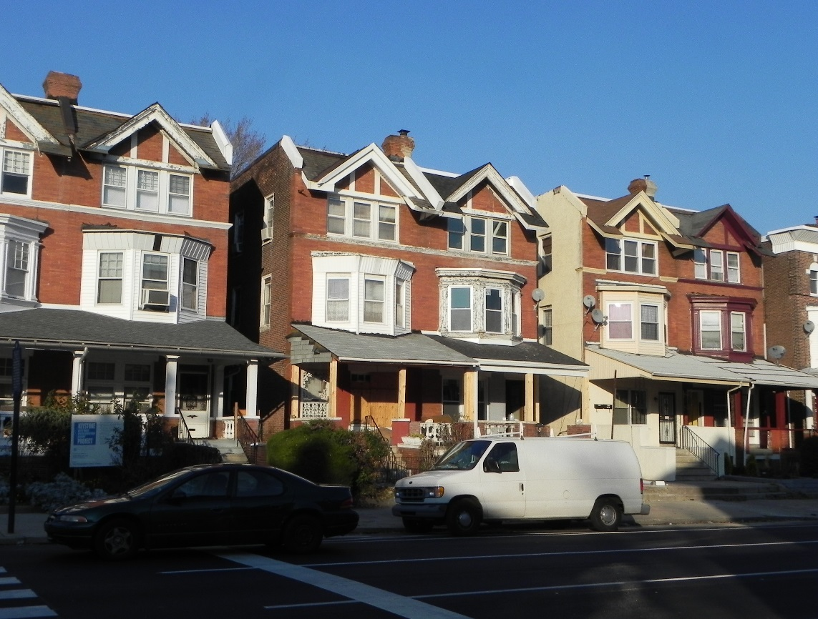
What is an eviction?
PENNSYLVANIANS FOR MODERN COURTS
A landlord can decide to evict a tenant for three reasons:
  The term of the lease has ended
  The tenant has violated conditions in the lease
  The tenant has failed to pay rent – there is a right to cure this nonpayment. However, if this happens on a number of occasions, split of opinion whether landlord can file a complaint for eviction
The tenant will receive a copy of the complaint in the mail and instructions to answer it.
A tenant can file a counterclaim right up to the hearing. This means the tenant wants to sue the landlord at the same hearing for any expenses, such as back rent.
“Self-Help Evictions”- when a landlord uses illegal means to evict a tenant. These can include: turning off utilities, changing locks, removing a tenant’s belongings, etc.

Slide 19
Going to Court
PENNSYLVANIANS FOR MODERN COURTS

Slide 20

How does a Civil Suit work?
PENNSYLVANIANS FOR MODERN COURTS
Civil Suit
Criminal Case
Between two litigants (plaintiff and defendant)
Between prosecutor, representing the state and its citizenry (not the victim), and defendant
Determines whether defendant is liable for injury or harm done to plaintiff
Determine whether defendant has broken the law
Plaintiff must have preponderance of evidence
Prosecutor must prove guilt beyond reasonable doubt
No right to an attorney
Right to an attorney

Slide 21
How a Case Gets to Court
PENNSYLVANIANS FOR MODERN COURTS
Landlord and/or tenant perceives a violation of the lease agreement or Landlord-Tenant law.
Landlord and/or tenant files a complaint with the Magisterial District Court where the property is located. There are fees involved with filing a case.
The Court may have advocates/ interviewers to assist in completing the necessary forms, but this is not legal advice.
The Plaintiff must then serve the complaint on the Defendant.
  If Plaintiff does not serve the Defendant or service is defective, then the case will be dismissed.
The Court will set a hearing date., typically 5-10 days after complaint is filed
  If defendant does not show up, the Court may enter judgment against the absent party
  If plaintiff does not show up, the court may dismiss the case.
Defendants can file a continuance to move the trial date back, and the Court may grant such continuances if justice so requires. These motions must be made in writing and filed at least (10) days before the hearing date.

Slide 22

What a landlord should bring to court to support its case
PENNSYLVANIANS FOR MODERN COURTS
The written lease
Housing Inspection License if operating a multi-unit building
A copy of the Notice to Quit, unless the lease waives this notice
Unpaid utility bills if the lease requires the tenant to pay them
Photographs of alleged damages
Proof of payment, invoices and estimates
Communications between parties about any damages
WHEN IN DOUBT, BRING EVERYTHING WITH YOU

Slide 23
What a tenant should bring to court to support its case
PENNSYLVANIANS FOR MODERN COURTS
To sue for repairs, habitability, running water
  The written lease
  Pictures of the conditions
  Notices to the landlord of the conditions
To sue for a security deposit:
  The written lease
  Documentation that the key was returned and a forwarding address was provided
  Documents from the tenant to the landlord demanding the return of the security deposit
  WHEN IN DOUBT, BRING EVERYTHING WITH YOU.

Slide 24
Who has power?
PENNSYLVANIANS FOR MODERN COURTS
Judges
  Rulings are binding, but may be appealed
Court staff
  Can direct people where to go and enforce court etiquette rules
Lawyers
  Provide access to the judicial system
Pro se parties
  Represent themselves without a lawyer, may be able to request to record the proceeding
Security
  Can remove unruly individuals from the courtroom.
  The courtroom is a public area, however, and all people are allowed to observe judicial proceedings. All parties should treat each other with respect and with courtesy.

Slide 25
Obtaining a Stay of Eviction
PENNSYLVANIANS FOR MODERN COURTS
If a judge has granted a landlord an order for possession, a tenant must file a Notice of Appeal within 10 days to pause an eviction.
If a tenant does this, they must pay their monthly rent money into an “escrow” account. This is a separate bank account that shows you are still able to pay rent while the appeal is taking place. If the tenant wins the appeal, the tenant will stay and the landlord will receive the money.
If a tenant is low-income, they may qualify for an In Forma Pauperis (IFP) waiver. This waiver will allow the tenant to pay only 1/3 of the monthly rent into an escrow account. The other 2/3 will made payable within 20 days.

Slide 26
Appealing a decision
PENNSYLVANIANS FOR MODERN COURTS
If a landlord or tenant wants to appeal a decision, they must first file a “Notice of Appeal” with the Department of Court Records, Civil/Family Division (DCRCFD). Or with the Prothonotary (outside of Philadelphia)
  If a money judgment was entered, either party has 30 days after the judgment to appeal.
  If an “order for possession” was issued, an appeal must be filed within 10 days.
The Notice of Appeal will be served on the other party. Once they receive the notice, they have 20 days to file a response.
The appeal will be scheduled for a mandatory arbitration hearing. This means a panel of lawyers will act as a judge and will hear the case and evidence “de novo” (without knowing the decision of the previous court).
The arbitration panel will reach a decision. If any party is unhappy with the decision, they can file a “Notice of Appeal of the Arbitration Award.”
This case may then go to the Court of Common Pleas for a trial.

Slide 27
COVID MORATORIUMS
There is a federal eviction moratorium through October 3, 2021 – CDC
https://cdc.gov/coronavirus/2019-ncov/communication/Signed=CDC-Eviction-Order.pdf
Must complete a CDC Declaration form, sign it and present to landlord
https://cdc/gov/coronavirus/2019-ncov/downloads/declaration-form.pdf
No Order of Possession shall be issued or acted upon in the 5th Judicial District as long as the CDC Order continues to apply to the case. CDC Order applies to end of lease cases as well as non-payment of rent cases

Slide 28
Emergency Rental Assistance Program
(ERAP)
PENNSYLVANIANS FOR MODERN COURTS
The Covid-19 pandemic has caused ongoing economic losses to landlords and tenants. An unprecedented number of potential evictions was anticipated by government officials across the country.
In December, 2020 and March, 2021, Congress passed two laws making monies available to state and local governments to prevent unnecessary evictions due to Covid 19. The states and local governments were responsible to pass the funds on for use by landlords and tenants.
The US Department of Treasury (Treasury) refers to these two laws, taken together, as the Emergency Rental Assistance Program. The Allegheny County Department of Human Services (ACDHS) is the local government agency responsible to work with Treasury and process the applications of local landlords and tenants who seek ERAP funds.
Applications to ACDHS for ERAP funds take about 30 to 45 days to process.

Slide 29
ERAP Application Form & Assistance
PENNSYLVANIANS FOR MODERN COURTS
Allegheny County Department of Human Services (ACDHS). Submit the ERAP application at:
https://covidrentrelief.alleghenycounty.us/
Action Housing administers the ERAP Applications for ACDHS. Contact Action Housing for assistance:
https://actionhousing.org/our-services/emergency-rental-assistance-program/

Slide 30
Allegheny County Response to Covid-19 and ERAP
PENNSYLVANIANS FOR MODERN COURTS
Due to the lengthy application process to receive ERAP funds, approximately 60 million dollars of ERAP funds remained to be distributed in Allegheny County as of August 4, 2021.
The judges of the Allegheny County Courts recognized the lengthy application process would lead to many unnecessary evictions. Landlords and tenants were running out of time to receive the ERAP funds. In addition, the Allegheny County Courts realized the strict procedural timelines the Magistrate District Judges were required to follow in eviction cases would prevent residents from receiving the funds many were entitled to.
On August 6, 2021, the Allegheny County Courts received permission from the Pennsylvania Supreme Court to suspend several of the strict timeline requirements in landlord-tenant cases before Magistrate District Courts.

Slide 31
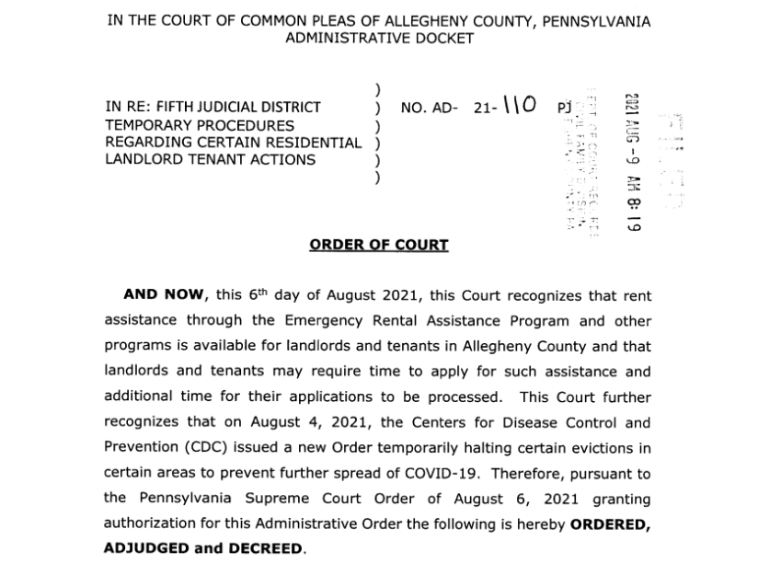

Slide 32
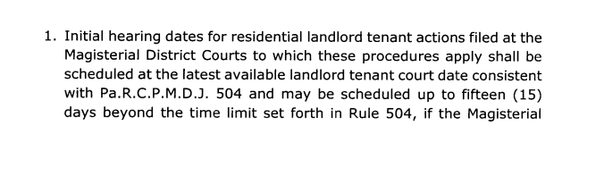
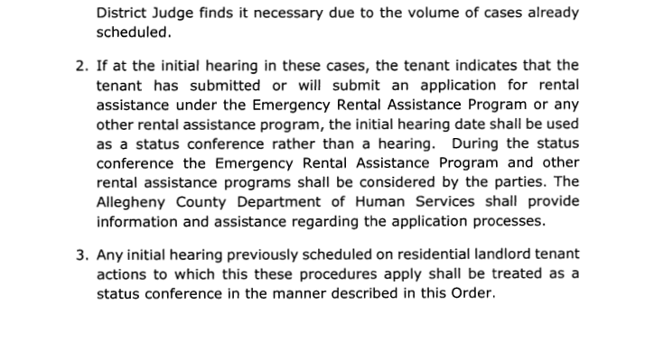

Slide 33
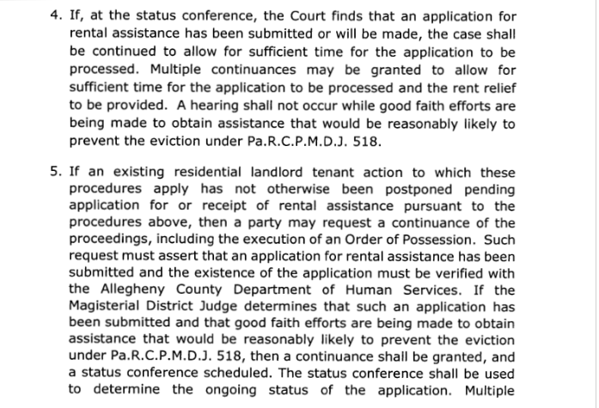

Slide 34
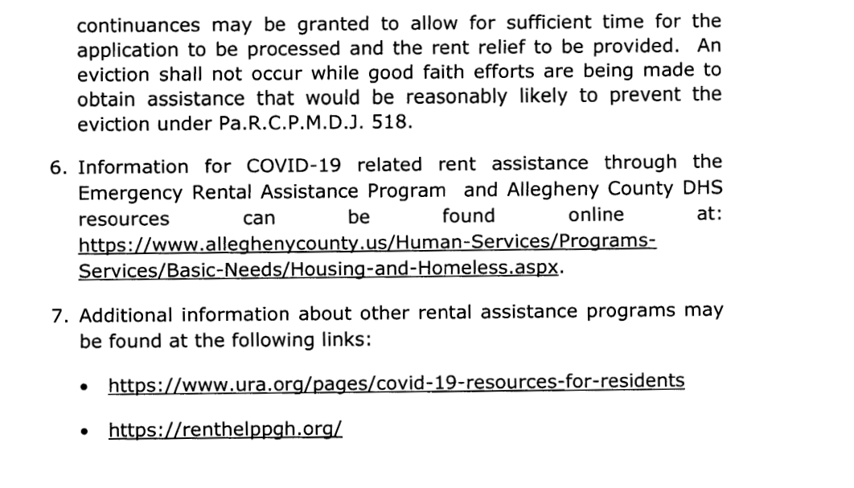

Slide 35
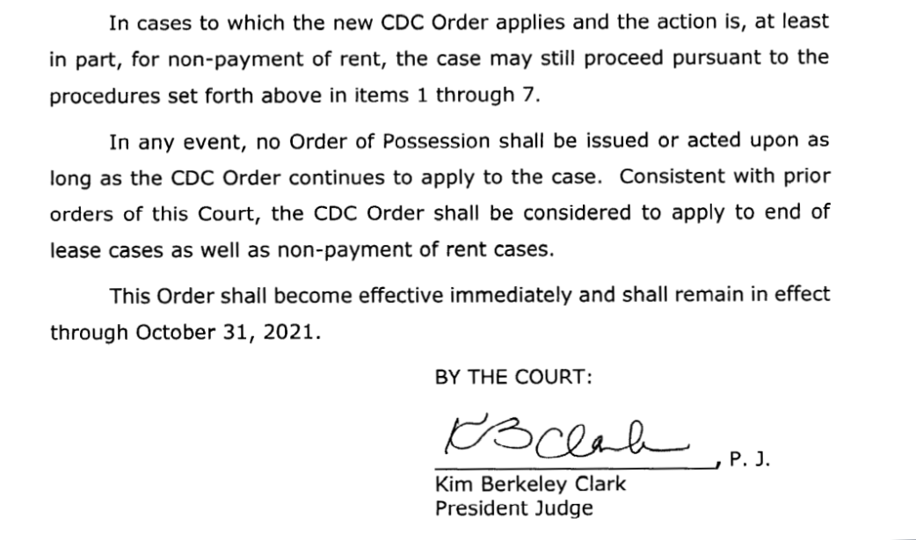

Slide 36
How did August 6 Order Change Eviction Procedure in Magistrate District Courts?
PENNSYLVANIANS FOR MODERN COURTS
Example 1: Until October 31, 2021, ACDHS employees attend landlord-tenant hearings to help parties apply for ERAP funds;
Example 2: The initial hearing in such cases can be scheduled up to 15 days beyond the time set under the prior rules. Instead of a hearing, this meeting may be treated as a status conference for the parties to consider making application or for checking the status of their existing applications;
Example 3: The case proceedings would allow postponements so that evictions would not occur while good faith efforts were being made to obtain rental assistance. These efforts must be “reasonably likely to prevent the eviction” that would have occurred under the prior strict timelines.

Slide 37
Other Resources
PENNSYLVANIANS FOR MODERN COURTS
Neighborhood Legal Services
Free legal help in civil cases for eligible clients
412-255-6700
Online intake available at www.nlsa.us
Pittsburgh office:
928 Penn Avenue
Pittsburgh, PA 15222
Other offices serve Beaver, Butler and Lawrence counties: 1-866-761-6572
Pennsylvanians for Modern Courts Pittsburgh Contact: Tom Bailey, 412-467-9262 or Tbailey@pmconline.org
Pennsylvania Courts website, “Learn,” http://www.pacourts.us/learn
Philadelphia Bar Association, “For the Public,” http://www.philadelphiabar.org/page/ForThePublic?appNum=2
Pennsylvanians for Modern Courts, “About the Courts,” http://pmconline.org/home

Slide 38
Allegheny County Law Library
PENNSYLVANIANS FOR MODERN COURTS
Pennsylvania Landlord and Tenant Law
Primary Sources
1) Statutes (State laws):
Purdon’s Pennsylvania Statutes, Annotated
  Title 68, Real and Personal Property;
  Chapter 8, Landlord and Tenant; Section 250.101 et.seq.
2) Administrative Codes and Regulations:
Pennsylvania Code
  Title 246, Minor Courts Civil Rules
Pennsylvania Bulletin
Pennsylvania Rules of Court Magisterial District Judges. Rule 501-582.

Slide 39
3) PA Cases:
West’s Pennsylvania Digest 2d Landlord and Tenant
Secondary Sources
1) Encyclopedias
Pennsylvania Law Encyclopedia, 2d
Vols. 30 & 31, Landlord and Tenant KFP65.P42
Standard Pennsylvania Practice 2d. Landlord and tenant KFP530.S7
Summary of Pennsylvania Jurisprudence 2d. Vol. 8 Property. KFP65.L42
2) Citators
Shepard’s Pennsylvania Citations
KeyCite (Westlaw)
PENNSYLVANIANS FOR MODERN COURTS

Slide 40
3) Book Subjects
Pennsylvania landlord and tenant
Pennsylvania leases
Pennsylvania evictions
Also, browse the Main Reading Room shelves at KFP117
4) Forms
Civil / Housing Court Forms, Filing Fees & FAQs
https://www.alleghenycourts.us/civil/Housing_Court.aspx
Dunlap-Hanna Pennsylvania Forms.
Vol. 5 Real Property, Chapter 58 Leases KFP68.M4
PENNSYLVANIANS FOR MODERN COURTS

Slide 41
5) Introductory Resources
*Every Landlord’s Legal Guide by Marcia Stewart, Ralph Warner & Janet Portman. 13th ed. KF590.Z9S74 2016 Self-Help Collection
*Every Tenant’s Legal Guide by Janet Portman and Marcia Stewart. 8th ed. KF590.Z9P67 2015 Self-Help Collection
*Landlord Tenant Law in a Nutshell by David S. Hill. 6th ed. KF590 .Z9 H45 2018
Renter’s Rights: the Basics by Janet Portman and Marcia Stewart. 9th ed. KF 590 .Z9 673 2018 Self-Help Collection
*Understanding Property Law by John Sprankling. KF561 .S67 2017 4th ed. located at DCLI
6) Treatises (2012 or newer)
*Bisel’s Pennsylvania Real Estate Lawsource. KFP112 .A3 2021
*Landlord-tenant Law: From Lease to Eviction. NBI KFP117 .A75 L3635 2020
*Representing Residential Landlords and Tenants. PBI. KFP117 .R46 2020
*Retail, Office and Restaurant Leases: Key Provisions and Warranties by Charles E. Bobins. NBI. KFP117.3 .A75 R48 2015
*Retail, Office and Restaurant Leases: Key Provisions and Warranties by Thomas Gacki. NBI. KFP117.3 .A75 R48 2015b
*Thorny Issues in Pennsylvania Landlord Tenant Law. PBI. KFP117 .A75 T48 2016
=/states/pennsylvania/renting/tenantright
PENNSYLVANIANS FOR MODERN COURTS

Slide 42
7) Websites
*Overview of Landlord-Tenant Laws in Pennsylvania. NOLO - http://www.nolo.com/legal-encyclopedia/overview-landlord-tenant-laws-pennsylvania.html
*Pennsylvania Landlord Tenant Law Landlord Protection Agency – https://www.thelpa.com/lpa/landlord-tenant-law/pennsylvania-landlord-tenant-law.html
*Pennsylvania Rental Laws Apartments.com - https://www.apartments.com/rental-manager/resources/state-laws/pennsylvania
*Pennsylvania Security Deposit Law Landlord Protection Agency – https://www.thelpa.com/lpa/landlord-tenant-law/pennsylvania-security-deposit-law.html
*Tenant Rights PaLawHelp.org - https://www.palawhelp.org/issues/housing- *and-shelter/tenants-rights
*Tenant Rights, Laws and Protections: Pennsylvania HUD - https://portal.hud.gov/hudportal/HUD?src
PENNSYLVANIANS FOR MODERN COURTS

Slide 43
Questions?
PENNSYLVANIANS FOR MODERN COURTS

